Slide 1
Deep Learning Tutorial
李宏毅
Hung-yi Lee
Notes:
Session 1 (09:30 - 10:30)Session 2 (10:50 - 12:30)Session 3 (14:00 - 15:00)Session 4 (15:20 - 17:00)
此外要提醒您此次課程時間是 2 / 12 ( 一 ) 與 2 / 13 ( 二 ) 的早上 9:30 到下午 6:00

Slide 2
Outline
2. Why Deep?
1. Introduction of Deep Learning
3. Gradient Descent
4. Backpropagation (Option)
5. Tips for Deep Learning
6. Convolutional Neural Network (CNN)
7. Auto-encoder (Option)

Slide 3
Introduction of Deep Learning
Notes:
Actually for every machine learning
Three things: model, cost, learning

Slide 4
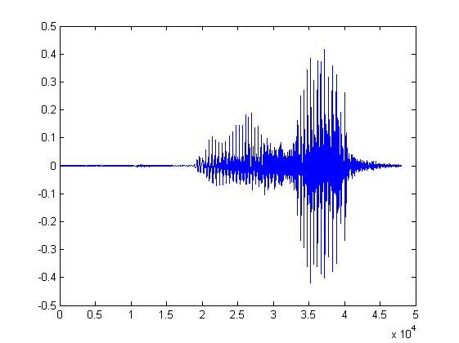

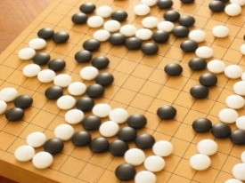
Machine Learning ≈ Looking for a Function
Speech Recognition
Image Recognition
Playing Go
Dialogue System
“How are you”
“Cat”
“5-5”
(next move)
“Hi”
“Hello”
(what the user said)
(system response)

Slide 5
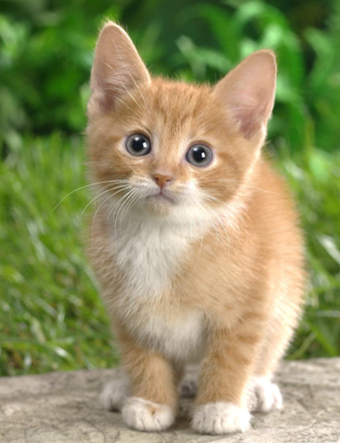

Framework
Image Recognition:
“cat”
A set of function
Model
“cat”
“money”
“dog”
“snake”
Notes:
Repeat again

Slide 6
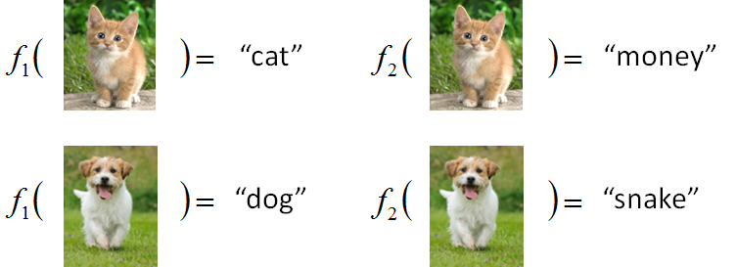

Framework
Image Recognition:
“cat”
A set of function
Model
Better!
Goodness of function f
Supervised Learning
Training
Data
function input:
function output:
“monkey”
“cat”
“dog”
Notes:
Repeat again

Slide 7
Framework
Image Recognition:
“cat”
A set of function
Model
Training
Testing
“cat”
Step 1
Goodness of function f
Pick the “Best” Function
Using
Step 2
Step 3
Training
Data
“monkey”
“cat”
“dog”
Notes:
Repeat again

Slide 8
Three Steps for Deep Learning
Step 1: define a set of function
Step 2: goodness of function
Step 3: pick the best function
Neural Network

Slide 9
Neural Network
Neuron
A simple function
…
…
…
…
Activation function
weights
bias
Notes:
sigmoid

Slide 10
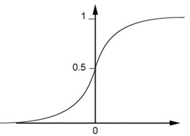
Neural Network
Neuron
Sigmoid Function
2
1
4
-1
-2
0.98
Activation function
-1
1
weights
1
bias
Notes:
sigmoid

Slide 11
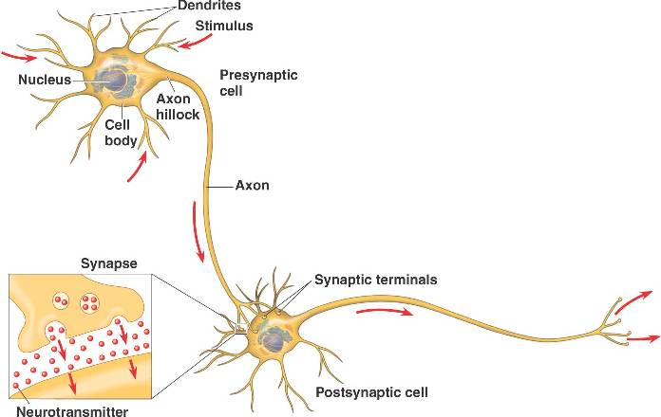
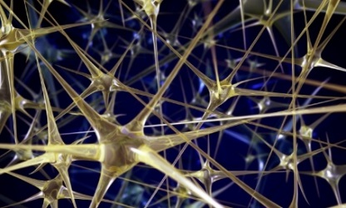

Neural Network
Different connections lead to different network structures
也就是不同的天賦
The neurons have different values of weights and biases.
機器自己後天學習的成果
Weights and biases are called network parameters $θ$
Notes:
The values of weights and biases will be obtained by learning (step 3).

Slide 12
Fully Connect Feedforward Network
1
4
0.98
1
-2
1
-1
-2
0.12
-1
1
0
Sigmoid Function

Slide 13
Fully Connect Feedforward Network
1
4
0.98
2
0.86
3
0.62
1
-2
-1
-1
1
0
-2
-1
-2
0.12
-2
0.11
-1
0.83
-1
1
-1
4
0
0
2

Slide 14
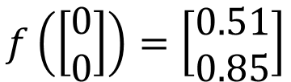
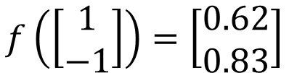

Fully Connect Feedforward Network
1
0.73
2
0.72
3
0.51
0
-2
-1
-1
1
0
-2
-1
0.5
-2
0.12
-1
0.85
0
1
-1
4
0
0
2
This is a function.
$$f\left(\left[\begin{matrix}1 \\ −1\end{matrix}\right]\right)=\left[\begin{matrix}0.62 \\ 0.83\end{matrix}\right]$$
$$f\left(\left[\begin{matrix}0 \\ 0\end{matrix}\right]\right)=\left[\begin{matrix}0.51 \\ 0.85\end{matrix}\right]$$
Input vector, output vector
Given parameters $θ$, define a function
Given network structure, define a function set
Notes:
For example, if we modify “1” to “2”, then we have another function

Slide 15
Fully Connect Feedforward Network
neuron
Input
Layer 1
Layer 2
Layer L
Output
……
y₁
……
y₂
……
……
……
……
……
……
y_{M}
Input Layer
Output Layer
Hidden Layers
Deep means many hidden layers

Slide 16
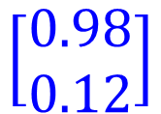

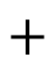
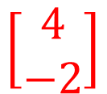
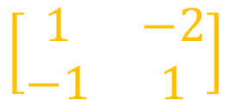
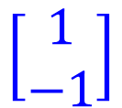

Matrix Operation
1
4
0.98
1
-2
1
-1
-2
0.12
-1
1
0
$$\left[\begin{matrix}1 & −2 \\ −1 & 1\end{matrix}\right]$$
$$\left[\begin{matrix}1 \\ −1\end{matrix}\right]$$
$$\left[\begin{matrix}1 \\ 0\end{matrix}\right]$$
$$=$$
$$\left[\begin{matrix}0.98 \\ 0.12\end{matrix}\right]$$
$$σ\left( \right)$$
$$+$$
$$\left[\begin{matrix}4 \\ −2\end{matrix}\right]$$
Notes:
Make sure you know how to do it
author: Adam Coates, Baidu, Inc.
Deep Learning (hopefully faster)
http://videolectures.net/deeplearning2015_coates_deep_learning/

Slide 17
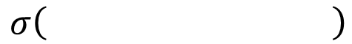
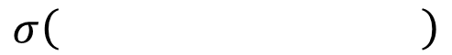
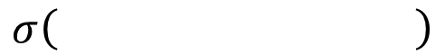
Neural Network
……
y₁
W¹
W²
W^{L}
……
y₂
b¹
b²
b^{L}
……
……
……
……
……
x
a¹
a²
y
……
y_{M}
W¹
x
b¹
+
$$σ\left( \right)$$
a¹
b²
W²
+
$$σ\left( \right)$$
W^{L}
b^{L}
a^{L-1}
+
$$σ\left( \right)$$
Notes:
Draw it?

Slide 18
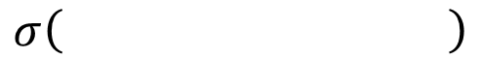
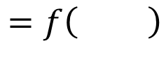
Neural Network
……
y₁
W¹
W²
W^{L}
……
y₂
b¹
b²
b^{L}
……
……
……
……
……
x
a¹
a²
y
……
y_{M}
y
x
Using parallel computing techniques to speed up matrix operation
$$=f\left( \right)$$
W^{L}
…
W²
W¹
x
b¹
b²
…
b^{L}
+
+
+
$$σ\left( \right)$$
$$=σ\left( \right)$$
$$σ\left( \right)$$
Notes:
Draw it?

Slide 19
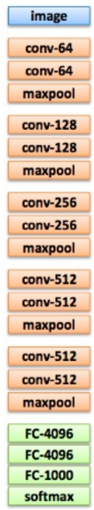
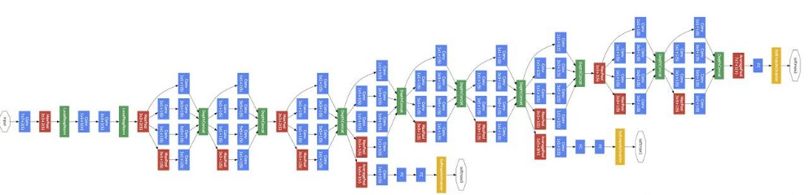
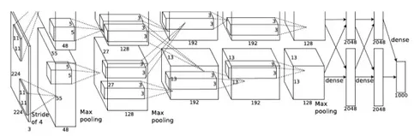
Deep = Many hidden layers
22 layers
http://cs231n.stanford.edu/slides/winter1516_lecture8.pdf
19 layers
8 layers
6.7%
7.3%
16.4%
AlexNet (2012)
VGG (2014)
GoogleNet (2014)

Slide 20

Deep = Many hidden layers
101 layers
152 layers
Special
structure
3.57%
7.3%
6.7%
16.4%
AlexNet (2012)
VGG
(2014)
GoogleNet
(2014)
Residual Net
(2015)
Taipei
101
Notes:
，曾於2004年12月31日至2010年1月4日間擁有世界第一高樓的紀錄

Slide 21
Highway Network
Residual Network
Highway Network
+
copy
Gate controller
copy
Deep Residual Learning for Image Recognition
http://arxiv.org/abs/1512.03385
Training Very Deep Networks
https://arxiv.org/pdf/1507.06228v2.pdf

Slide 22
output layer
output layer
output layer
Highway Network automatically
determines the layers needed!
Input layer
Input layer
Input layer

Slide 23
Output Layer
Softmax layer as the output layer
Ordinary Layer
In general, the output of network can be any value.
May not be easy to interpret
Notes:
Original output layer is local

Slide 24
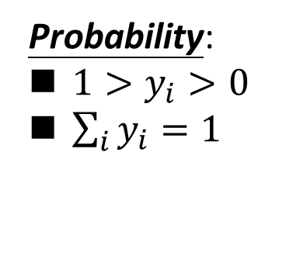
Output Layer
Probability:
$1>y_{i}>0$
$\sum_{i}{y_{i}=1}$
Softmax layer as the output layer
Softmax Layer
3
20
0.88
1
2.7
0.12
-3
0.05
≈0
Notes:
Why it is name soft max?
Monotonicity of softmax
Non-locality of softmax

Slide 25
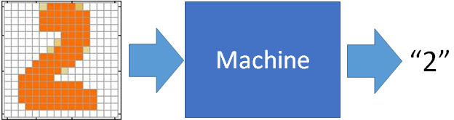
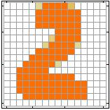
Example Application
Input
Output
y₁
is 1
0.1
y₂
is 2
0.7
The image is “2”
……
……
……
y₁₀
0.2
is 0
16 x 16 = 256
Ink → 1
No ink → 0
Each dimension represents the confidence of a digit.
Notes:
The same for even more complex tasks.

Slide 26
Example Application
Input
Layer 1
Layer 2
Layer L
Output
……
y₁
is 1
……
A function set containing the candidates for
Handwriting Digit Recognition
y₂
is 2
“2”
……
……
……
……
……
……
……
y₁₀
is 0
Input Layer
Output Layer
Hidden Layers
You need to decide the network structure to let a good function in your function set.

Slide 27
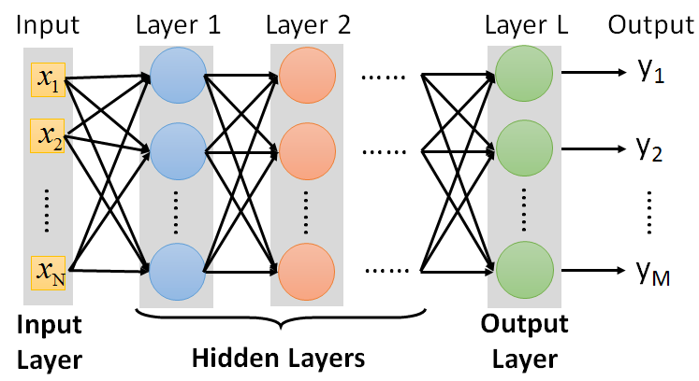
FAQ
Q: How many layers? How many neurons for each layer?
Q: Can we design the network structure?
Q: Can the structure be automatically determined?
Yes, but not widely used yet ……
Trial and Error
+
Intuition
E.g. Convolutional Neural Network (CNN)

Slide 28
Three Steps for Deep Learning
Step 1: define a set of function
Step 2: goodness of function
Step 3: pick the best function

Slide 29


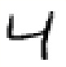





Training Data
Preparing training data: images and their labels
“5”
“0”
“4”
“1”
“9”
“2”
“1”
“3”
The learning target is defined on the training data.
Notes:
(學習教材)

Slide 30


Learning Target
……
y₁
is 1
……
y₂
Softmax
is 2
……
……
……
……
y₁₀
is 0
16 x 16 = 256
Ink → 1
No ink → 0
The learning target is ……
Input:
y₁ has the maximum value
Input:
y₂ has the maximum value

Slide 31

Loss
A good function should make the loss of all examples as small as possible.
“1”
……
y₁
1
As close as possible
……
y₂
Given a set of parameters
0
Softmax
……
……
……
……
……
Loss
$$l$$
……
y₁₀
0
Loss can be square error or cross entropy between the network output and target
target
Notes:
With softmax, the summation of all the ouputs would be one.
Can be considered as probability if you want ……

Slide 32
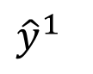
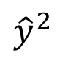
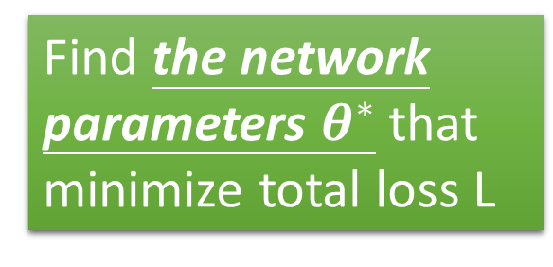
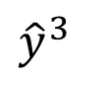
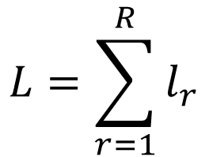
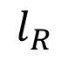
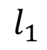
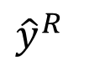
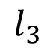
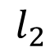
Total Loss
Total Loss:
$$L=\sum_{r=1}^{R}{l_{r}}$$
For all training data …
x¹
NN
y¹
$${\hat{y}}^{1}$$
$$l_{1}$$
As small as possible
x²
NN
y²
$${\hat{y}}^{2}$$
Find a function in function set that minimizes total loss L
$$l_{2}$$
x³
NN
y³
$${\hat{y}}^{3}$$
$$l_{3}$$
……
……
……
……
Find the network parameters $θ^{∗}$ that minimize total loss L
x^{R}
NN
y^{R}
$${\hat{y}}^{R}$$
$$l_{R}$$
Notes:
Randomly picked one
Two approaches update the parameters towards the same direction, but stochastic is faster!
Better!

Slide 33
Three Steps for Deep Learning
Step 1: define a set of function
Step 2: goodness of function
Step 3: pick the best function

Slide 34


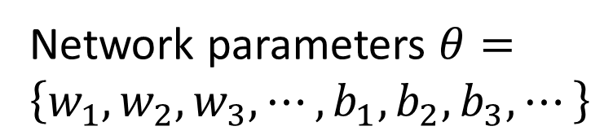
How to pick the best function
Find network parameters $θ^{∗}$ that minimize total loss L
Layer l
Layer l+1
Enumerate all possible values
Network parameters $θ=\left\{w_{1},w_{2},w_{3},⋯,b_{1},b_{2},b_{3},⋯\right\}$
10⁶
weights
……
……
Millions of parameters
E.g. speech recognition: 8 layers and 1000 neurons each layer
1000
neurons
1000
neurons
Notes:
百萬等級的
Solving this optimization problem by Calculus or something

Slide 35
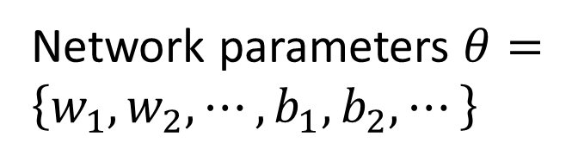
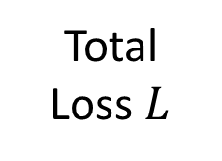
Gradient Descent
Network parameters $θ=\left\{w_{1},w_{2},⋯,b_{1},b_{2},⋯\right\}$
Find network parameters $θ^{∗}$ that minimize total loss L
Pick an initial value for w
Total
Loss $L$
Random, RBM pre-train
Usually good enough
Notes:
Consider a parameter w in $θ$

Slide 36

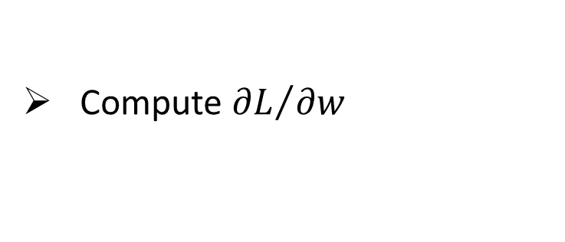
Gradient Descent
Network parameters $θ=\left\{w_{1},w_{2},⋯,b_{1},b_{2},⋯\right\}$
Find network parameters $θ^{∗}$ that minimize total loss L
Pick an initial value for w
Total
Loss $L$
Compute ${∂L}/{∂w}$
Negative
Increase w
Positive
Decrease w
http://chico386.pixnet.net/album/photo/171572850
Notes:
Consider a parameter w in $θ$
切線斜率

Slide 37
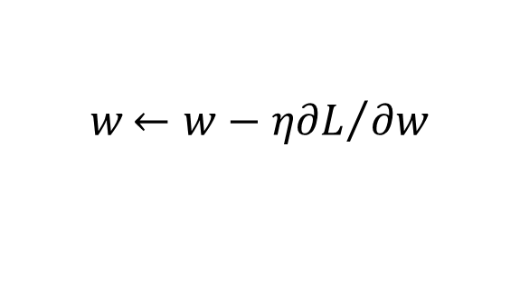
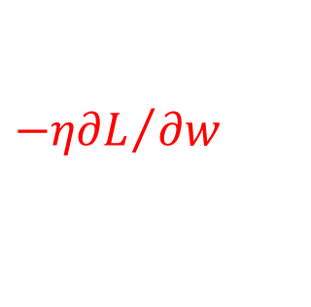
Gradient Descent
Network parameters $θ=\left\{w_{1},w_{2},⋯,b_{1},b_{2},⋯\right\}$
Find network parameters $θ^{∗}$ that minimize total loss L
Pick an initial value for w
Total
Loss $L$
Compute ${∂L}/{∂w}$
$$w{←w−η∂L}/{∂w}$$
Repeat
η is called “learning rate”
$${−η∂L}/{∂w}$$
Notes:
eta
Consider a parameter w in $θ$

Slide 38
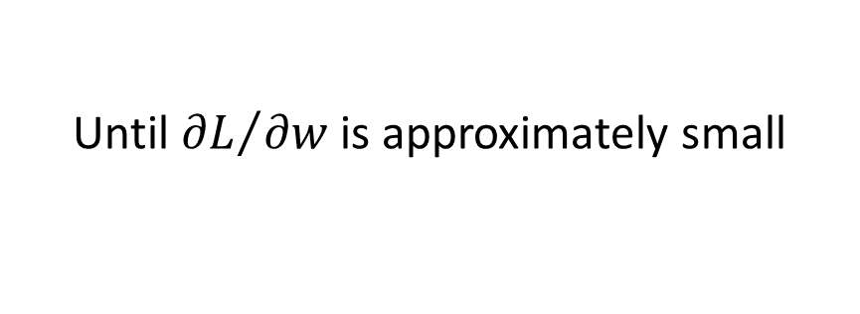
Gradient Descent
Network parameters $θ=\left\{w_{1},w_{2},⋯,b_{1},b_{2},⋯\right\}$
Find network parameters $θ^{∗}$ that minimize total loss L
Pick an initial value for w
Total
Loss $L$
Compute ${∂L}/{∂w}$
$$w{←w−η∂L}/{∂w}$$
Repeat
Until ${∂L}/{∂w}$ is approximately small
(when update is little)
Notes:
Consider a parameter w in $θ$

Slide 39
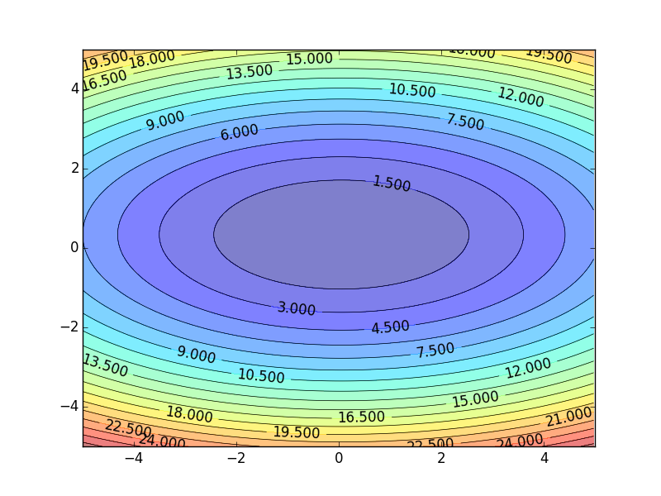
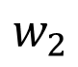
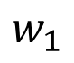
Gradient Descent
Color: Value of Total Loss L
$$w_{2}$$
Randomly pick a starting point
$$w_{1}$$
Notes:
A network can have millions of parameters.
Backpropagation is the way to compute the gradients efficiently (not today)
Ref: http://speech.ee.ntu.edu.tw/~tlkagk/courses/MLDS_2015_2/Lecture/DNN%20backprop.ecm.mp4/index.html

Slide 40
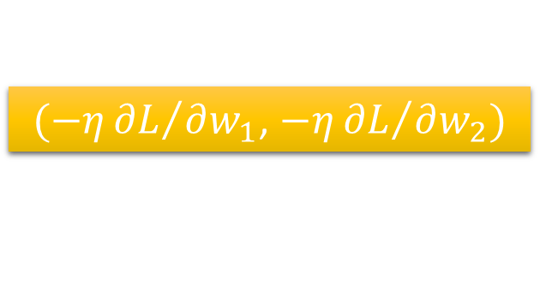
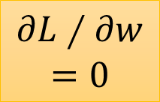
Gradient Descent
Hopfully, we would reach a minima …..
Color: Value of Total Loss L
$$w_{2}$$
$(−η{∂L}/{∂w_{1}}$, $−η{∂L}/{∂w_{2}})$
Compute ${∂L}/{∂w_{1}}$, ${∂L}/{∂w_{2}}$
$$w_{1}$$
Notes:
Questions: image you are playing AOC
A network can have millions of parameters.
Backpropagation is the way to compute the gradients efficiently (not today)
Ref: http://speech.ee.ntu.edu.tw/~tlkagk/courses/MLDS_2015_2/Lecture/DNN%20backprop.ecm.mp4/index.html

Slide 41
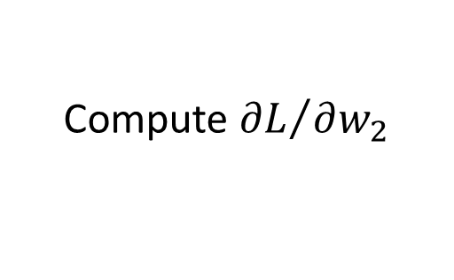











Gradient Descent
$$θ$$
Compute ${∂L}/{∂w_{1}}$
$$\left[\begin{aligned}\frac{∂L}{∂w_{1}} \\ \frac{∂L}{∂w_{2}} \\ ⋮ \\ \frac{∂L}{∂b_{1}} \\ ⋮\end{aligned}\right]$$
$$w_{1}$$
0.2
0.15
$$−μ{∂L}/{∂w_{1}}$$
Compute ${∂L}/{∂w_{2}}$
$$w_{2}$$
-0.1
0.05
$$∇L=$$
$$−μ{∂L}/{∂w_{2}}$$
……
Compute ${∂L}/{∂b_{1}}$
$$b_{1}$$
0.3
0.2
$$−μ{∂L}/{∂b_{1}}$$
……
gradient

Slide 42






Gradient Descent
$$θ$$
Compute ${∂L}/{∂w_{1}}$
Compute ${∂L}/{∂w_{1}}$
$$w_{1}$$
0.2
0.15
0.09
$$−μ{∂L}/{∂w_{1}}$$
$$−μ{∂L}/{∂w_{1}}$$
……
Compute ${∂L}/{∂w_{2}}$
Compute ${∂L}/{∂w_{2}}$
$$w_{2}$$
-0.1
0.05
0.15
$$−μ{∂L}/{∂w_{2}}$$
$$−μ{∂L}/{∂w_{2}}$$
……
……
Compute ${∂L}/{∂b_{1}}$
Compute ${∂L}/{∂b_{1}}$
$$b_{1}$$
0.3
0.2
0.10
$$−μ{∂L}/{∂b_{1}}$$
$$−μ{∂L}/{∂b_{1}}$$
……
……

Slide 43


Local Minima
Total
Loss
Very slow at the plateau
Stuck at saddle point
Stuck at local minima
$$∂L∕∂w$$
$$≈0$$
$$∂L∕∂w$$
$$=0$$
$$∂L∕∂w$$
$$=0$$
The value of a network parameter w

Slide 44




Local Minima
Gradient descent never guarantee global minima
Different initial point
$$L$$
Reach different minima, so different results
$$w_{1}$$
$$w_{2}$$
Notes:
看人品的方法
Who is Afraid of Non-Convex Loss Functions?
http://videolectures.net/eml07_lecun_wia/

Slide 46


Gradient Descent
This is the “learning” of machines in deep learning ……
Even alpha go using this approach.
People image ……
Actually …..
I hope you are not too disappointed :p

Slide 47









Backpropagation
Backpropagation: an efficient way to compute ${∂L}/{∂w}$ in neural network
libdnn
台大周伯威
同學開發
Ref: https://www.youtube.com/watch?v=ibJpTrp5mcE
Notes:
amazon-dsstne

Slide 48
Three Steps for Deep Learning
Step 1: define a set of function
Step 2: goodness of function
Step 3: pick the best function
Deep Learning is so simple ……
Now If you want to find a function
If you have lots of function input/output (?) as training data
You can use deep learning

Slide 49


For example, you can do …….
Image Recognition
“monkey”
“monkey”
Network
“cat”
“cat”
“dog”
“dog”

Slide 50


For example, you can do …….
“Talk” in e-mail
Spam
filtering
Network
1/0
(Yes/No)
“free” in e-mail
1 (Yes)
0 (No)
(http://spam-filter-review.toptenreviews.com/)
Notes:
Can we have more examples ….

Slide 51


For example, you can do …….
政治
“stock” in document
Network
經濟
體育
“president” in document
體育
政治
財經
http://top-breaking-news.com/

Slide 52

More ……
function input
function output
Machine Translation
“機器學習及其深層與結構化”
“Machine learning and having it deep and structured”
(sentence of language 1)
(sentence of language 2)
Speech Recognition
感謝大家來上課”
(speech)
(transcription)
Chat-bot
“How are you?”
“I’m fine.”
(what a user says)
(response of machine)
Notes:
課程名稱只能有12 個字

Slide 53






More ……
function input
function output
Image to Image
Colorization:
Ref: https://arxiv.org/pdf/1611.07004v1.pdf
Text to Image
“this white and yellow flower have thin white petals and a round yellow stamen”
ref: https://arxiv.org/pdf/1605.05396.pdf
Notes:
畫圖
上色

Slide 54

Anime Face Generation
圖片生成：
吳宗翰、謝濬丞、
陳延昊、錢柏均
Notes:
吳宗翰

Slide 55















G
G
G
G
G
G
G
G
G
G
$$\left[\begin{aligned}0.0 \\ 0.0\end{aligned}\right]$$
$$\left[\begin{aligned}0.1 \\ 0.1\end{aligned}\right]$$
$$\left[\begin{aligned}0.2 \\ 0.2\end{aligned}\right]$$
$$\left[\begin{aligned}0.3 \\ 0.3\end{aligned}\right]$$
$$\left[\begin{aligned}0.4 \\ 0.4\end{aligned}\right]$$
$$\left[\begin{aligned}0.5 \\ 0.5\end{aligned}\right]$$
$$\left[\begin{aligned}0.6 \\ 0.6\end{aligned}\right]$$
$$\left[\begin{aligned}0.7 \\ 0.7\end{aligned}\right]$$
$$\left[\begin{aligned}0.8 \\ 0.8\end{aligned}\right]$$
$$\left[\begin{aligned}0.9 \\ 0.9\end{aligned}\right]$$
感謝陳柏文同學提供實驗結果

Slide 56

根據文字敘述生成二次元人物
圖片生成：
吳宗翰、謝濬丞、
陳延昊、錢柏均

Slide 57

Concluding Remarks
Step 1: define a set of function
Step 2: goodness of function
Step 3: pick the best function
Deep Learning is so simple ……

Slide 58
Practice of Deep Learning
Previous machine learning developers
Carefully design your algorithm
Theoretically know its performance
Deep learning
Try first
Many results contradict our intuition
Find some reasons to explain what we observed
More like chemistry

Slide 59

Practice of Deep Learning
Ali Rahimi, Test of Time Award, NIPS 2017

